Slide 1




Project 1.6 Distributed Robotic Beamforming
Kushal Chakrabarti, Manik Kumar, Amrit Bedi, Nikhil Chopra (UMD, PI)
Fikadu Dagefu (ARL), Jeffrey Twigg (ARL)
ArtIAMAS Cooperative Agreement
Annual Review

Slide 2
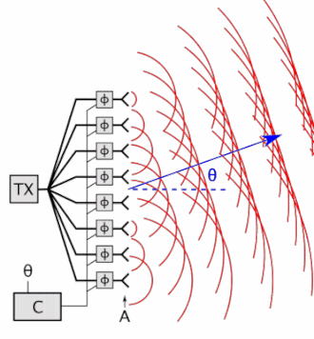
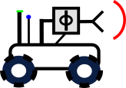
Distributed Beamforming
Objective: Wireless Communication in Presence of Near-peer Adversaries
Increasing Operational Tempo of Future Battles (Requires Autonomy)
Reliability in Complex Environments (e.g., Dense Urban, Indoors, Forests)
Inspiration: Phased Antenna Array
Distributed Robotic Beamforming
Creates coherent signal using multiple antennas
Directional, Controlled Pattern
Covert Comms
Targeted Jamming
Radar
Electronically steerable
Gain is N^2
5 Element Array @2W
= 1 50W Tx
Coherent
Phase Front
Distributed
Across
Robots
Distributed, resilient to single-agent failure
Agile, composed of evolving robot swarm
AI to adapt to environment and near-peer adversary
Phase Controller
N-element Phased Array

Slide 3
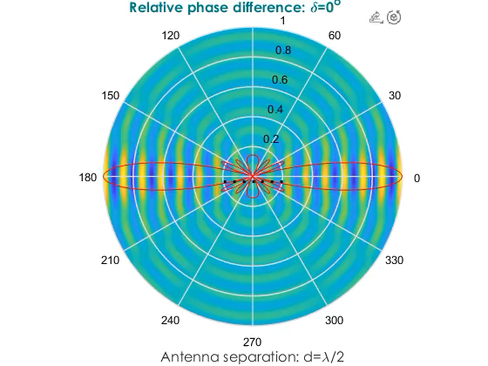
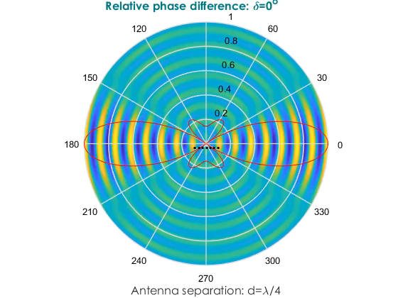
Controlling Covert Directional Communication
How do we control signal strength (signature management) in different desired directions simultaneously?

Slide 4

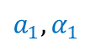
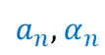
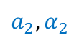
Proposed Settings of Beamforming Agents
server-agent based setting
agents communicate with server
no peer-to-peer communication
what is a server?
can be an auxiliary node, located close to the agents
can exchange information with the agents
can process information
need not know the beamforming problem
server
null Rx
target Rx
$$a_{1},α_{1}$$
$$a_{2},α_{2}$$
$$a_{n},α_{n}$$

Slide 5
Our Contributions (since Dec 21 start)
proposed a novel algorithm: Iteratively Pre-conditioned Gradient-descent for Distributed Beamforming (IPG-DB)
significantly faster than the gradient-descent (GD) based methods
does not rely on receiver feedbacks
does not assume channel fading parameters: robustness to channel noise
can be incorporated in alternate optimization framework for position, sparsity, and excitation in [1]: replace slower GD with faster IPG-DB
[1] Anjaly Parayil, Amrit Singh Bedi, and Alec Koppel. Joint position and beamforming control via alternating nonlinear least-squares with a hierarchical gamma prior. In 2021 American Control Conference (ACC), pages 3513–3518. IEEE, 2021.

Slide 6
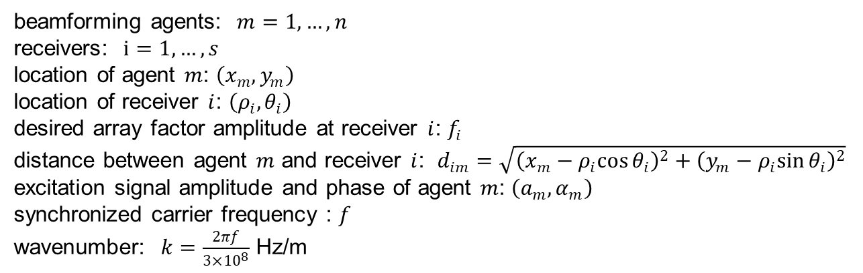
Problem Formulation: Notation
beamforming agents: $m=1,…,n$
receivers: $i=1,…,s$
location of agent $m$: $\left(x_{m},y_{m}\right)$
location of receiver $i$: $\left(ρ_{i},θ_{i}\right)$
desired array factor amplitude at receiver $i$: $f_{i}$
distance between agent $m$ and receiver $i$: $d_{im}=\sqrt{{\left(x_{m}−ρ_{i}cos{θ_{i}}\right)}^{2}+{\left(y_{m}−ρ_{i}sin{θ_{i}}\right)}^{2}}$
excitation signal amplitude and phase of agent $m$: $\left(a_{m},α_{m}\right)$
synchronized carrier frequency : $f$
wavenumber: $k=\frac{2πf}{3×{10}^{8}}$ Hz/m

Slide 7
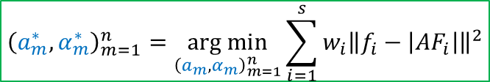
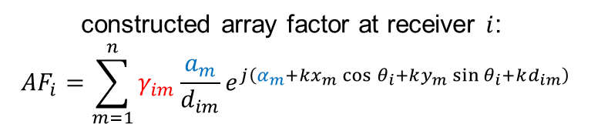
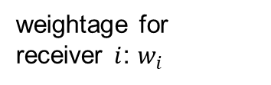
Problem Formulation
constructed array factor at receiver $i$:
$${AF}_{i}=\sum_{m=1}^{n}{γ_{im}\frac{a_{m}}{d_{im}}e^{j\left(α_{m}+kx_{m}\cos{θ_{i}}+ky_{m}\sin{θ_{i}+kd_{im}}\right)}}$$
unknown multipath fading
control parameters
weightage for receiver $i$: $w_{i}$
$${\left(a_{m}^{∗},α_{m}^{∗}\right)}_{m=1}^{n}=\underset{{\left(a_{m},α_{m}\right)}_{m=1}^{n}}{arg min}{\sum_{i=1}^{s}{w_{i}{\left\|f_{i}−\left|{AF}_{i}\right|\right\|}^{2}}}$$

Slide 8
Performance Measures of a Beamforming Approach
open-loop or closed-loop
feedback required?
unlikely to get feedback from null receivers
guarantee convergence
algorithm converges? (future work)
exact solution exists?
how many transmitting agents? (ongoing work)
rate of convergence
smaller number of iterations
characterize number of iterations (future work)
robustness
unknown channel parameters
receiver locations not precise (future work)
directivity
spread of combined signal in other directions? (future work)
node placement and node selection
optimize position and the number of active agents (future work)

Slide 9
Comparison with Related Works
Prior Works | Our Work
objective: maximizing gain or steering nulls at specific locations | objective: beampattern matching advantages: precise control over power at multiple locations, inherent beamforming and nullforming in constructive manner, can include additional constraints (limited transmit power, derivative constraints)
utilize receiver feedbacks | does not require receiver feedbacks
sparse beamforming, mobile agents | fixed number of agents, stationary agents
channel model-free, probabilistic channel prediction for minimizing power | feedback-free, objective: beampattern matching
receiver feedback-free | does not assume line of sight (LOS) channels

Slide 10
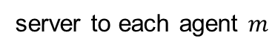
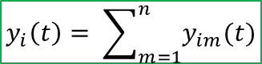
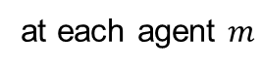
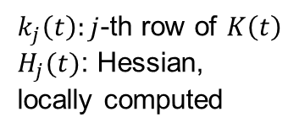

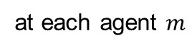
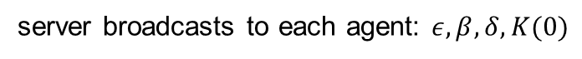
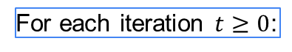
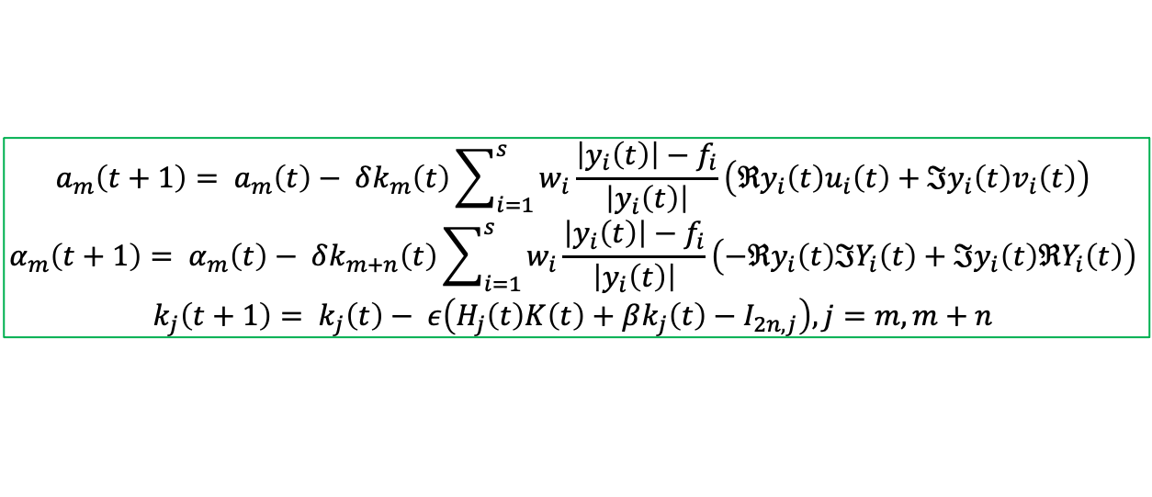
Algorithm Description: IPG-DB
agent $m$: $\left(a_{m}(t),α_{m}(t)\right)$, server: $K\left(t\right) ∈ ℝ^{2n×2n}$
server broadcasts to each agent: $ε, β, δ, K(0)$
For each iteration $t≥0$:
$$ζ_{im}=kx_{m}\cos{θ_{i}}+ky_{m}\sin{θ_{i}+kd_{im}}$$
$u_{im}(t)=\frac{1}{d_{im}}\cos\left(α_{m}\left(t\right)+ζ_{im}\right)$, $v_{im}\left(t\right)=\frac{1}{d_{im}}\sin\left(α_{m}\left(t\right)+ζ_{im}\right)$, $y_{im}\left(t\right)=a_{m}(t)\left(u_{im}\left(t\right)+jv_{im}(t)\right)$
at each agent $m$
$\left\{u_{im}\left(t\right),v_{im}\left(t\right),y_{im}\left(t\right), i=1,…,s\right\}$, $k_{m}\left(t\right),k_{m+n}\left(t\right)$
agent $m$ to server
$k_{j}\left(t\right):j$-th row of $K\left(t\right)$
$H_{j}(t)$: Hessian, locally computed
$$y_{i}\left(t\right)= \sum_{m=1}^{n}{y_{im}(t)}$$
at server
server to each agent $m$
$u_{i}\left(t\right)={\left[u_{i1}\left(t\right),…,u_{in}\left(t\right)\right]}^{T}$, $v_{i}\left(t\right)={\left[v_{i1}\left(t\right),…,v_{in}\left(t\right)\right]}^{T}$, $Y_{i}\left(t\right)={\left[y_{i1}\left(t\right),…,y_{in}\left(t\right)\right]}^{T}$
$\left\{y_{i}\left(t\right), i=1,…,s\right\}$,$\left\{u_{i}\left(t\right),v_{i}\left(t\right),Y_{i}\left(t\right), i=1,…,s\right\}$, $K\left(t\right)$
at each agent $m$
$$a_{m}\left(t+1\right)= a_{m}\left(t\right)− δk_{m}\left(t\right)\sum_{i=1}^{s}{w_{i}\frac{\left|y_{i}\left(t\right)\right|−f_{i}}{\left|y_{i}\left(t\right)\right|}}\left(ℜy_{i}\left(t\right)u_{i}\left(t\right)+ℑy_{i}\left(t\right)v_{i}\left(t\right)\right)$$
$$α_{m}\left(t+1\right)= α_{m}\left(t\right)− δk_{m+n}\left(t\right)\sum_{i=1}^{s}{w_{i}\frac{\left|y_{i}\left(t\right)\right|−f_{i}}{\left|y_{i}\left(t\right)\right|}}\left(−ℜy_{i}\left(t\right)ℑY_{i}\left(t\right)+ℑy_{i}\left(t\right)ℜY_{i}\left(t\right)\right)$$
$$k_{j}\left(t+1\right)= k_{j}\left(t\right)− ε\left(H_{j}\left(t\right)K\left(t\right)+βk_{j}\left(t\right)−I_{2n,j}\right), j=m,m+n$$

Slide 11
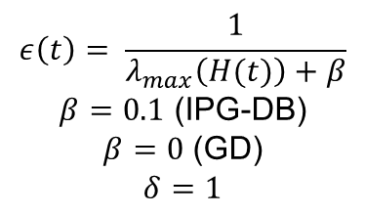
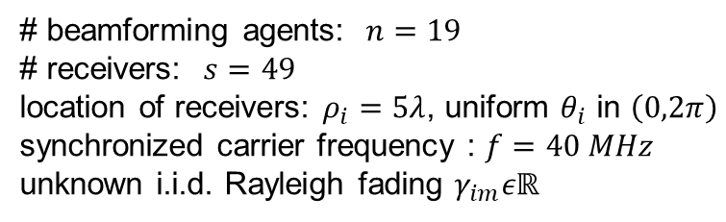
Empirical Results: Synthetic Data
# beamforming agents: $n=19$
# receivers: $s=49$
location of receivers: $ρ_{i}=5λ$, uniform $θ_{i}$ in $\left(0,2π\right)$
synchronized carrier frequency : $f=40 MHz$
unknown i.i.d. Rayleigh fading $γ_{im}εℝ$
$$ε\left(t\right)= \frac{1}{λ_{max}\left(H(t)\right)+β}$$
$β=0.1$ (IPG-DB)
$β=0$ (GD)
$$δ=1$$

Slide 12
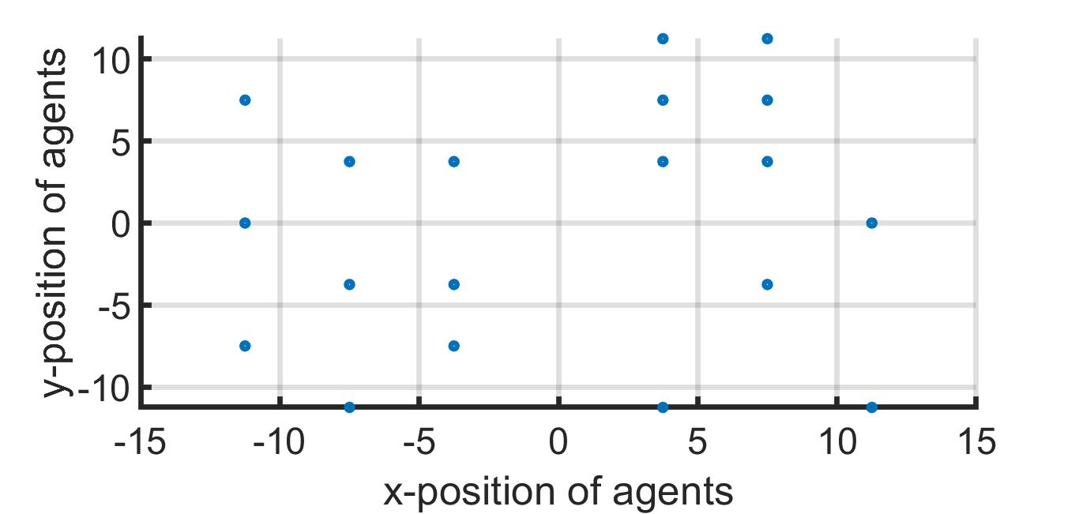
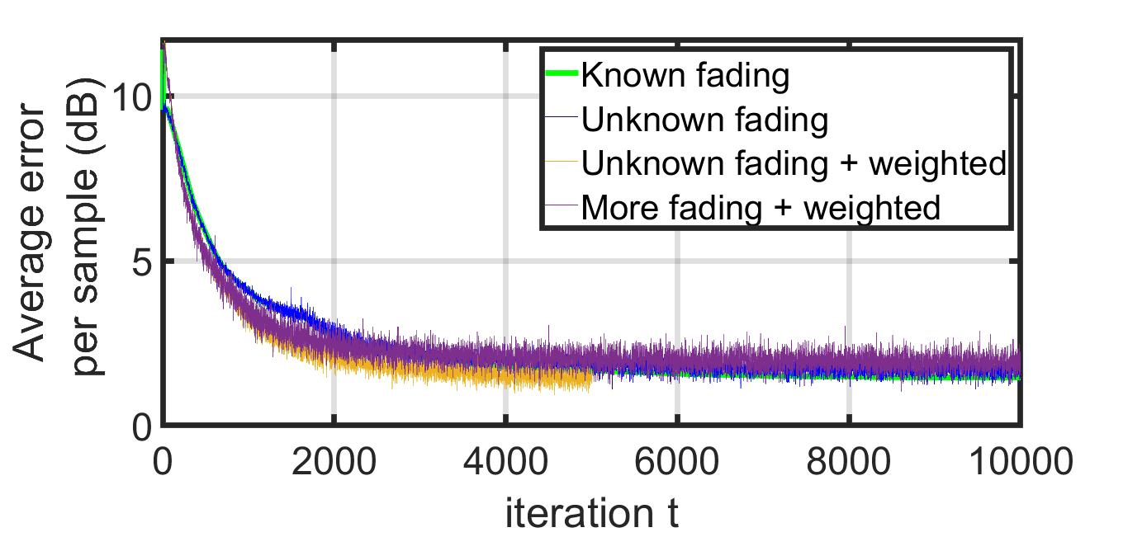
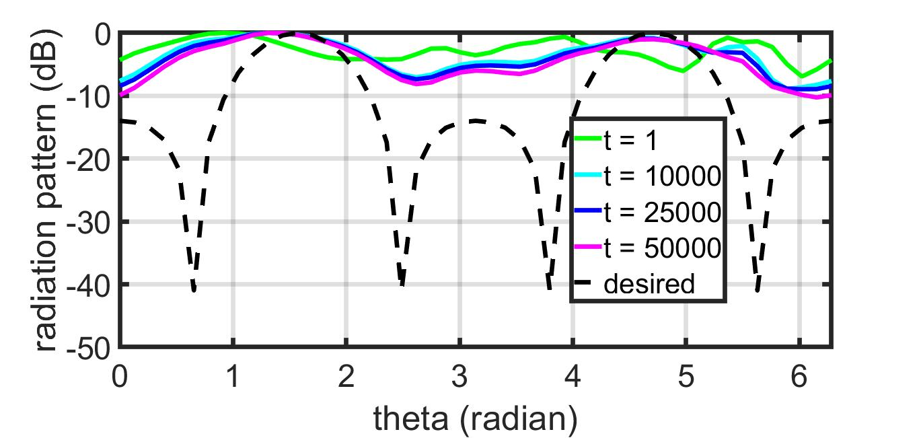
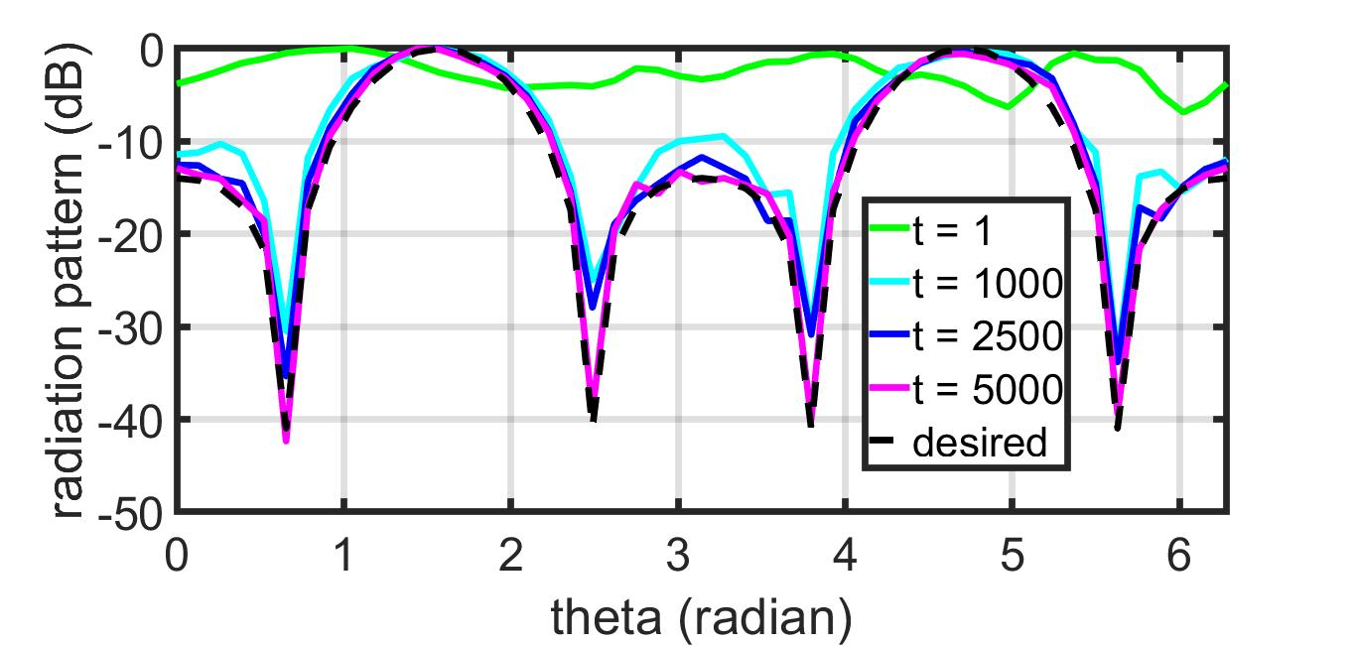
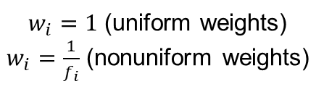
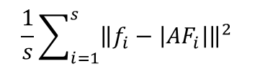
Empirical Results: Synthetic Data
$w_{i}=1$ (uniform weights)
$w_{i}=\frac{1}{f_{i}}$ (nonuniform weights)
$$\frac{1}{s}\sum_{i=1}^{s}{{\left\|f_{i}−\left|{AF}_{i}\right|\right\|}^{2}}$$
IPG-DB
GD
IPG-DB

Slide 13
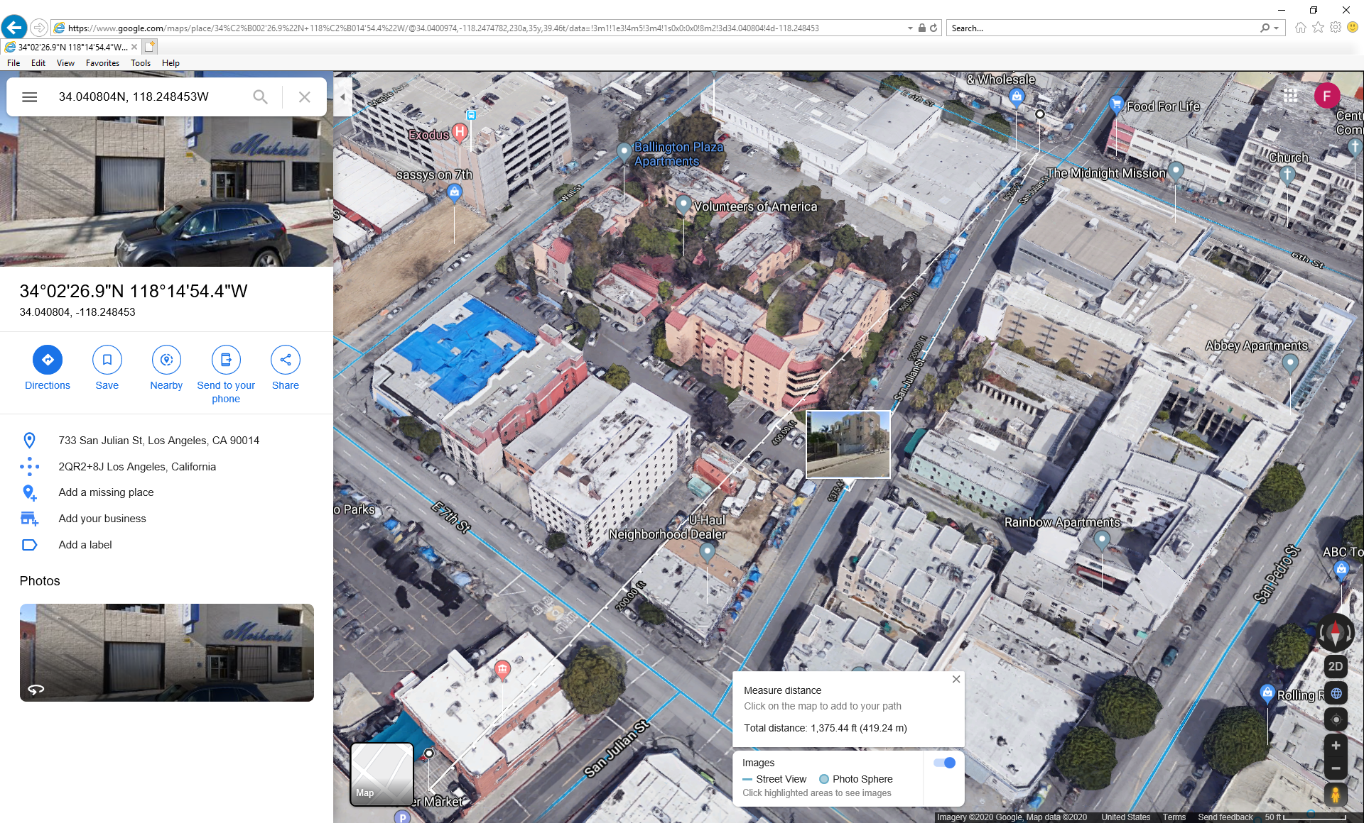
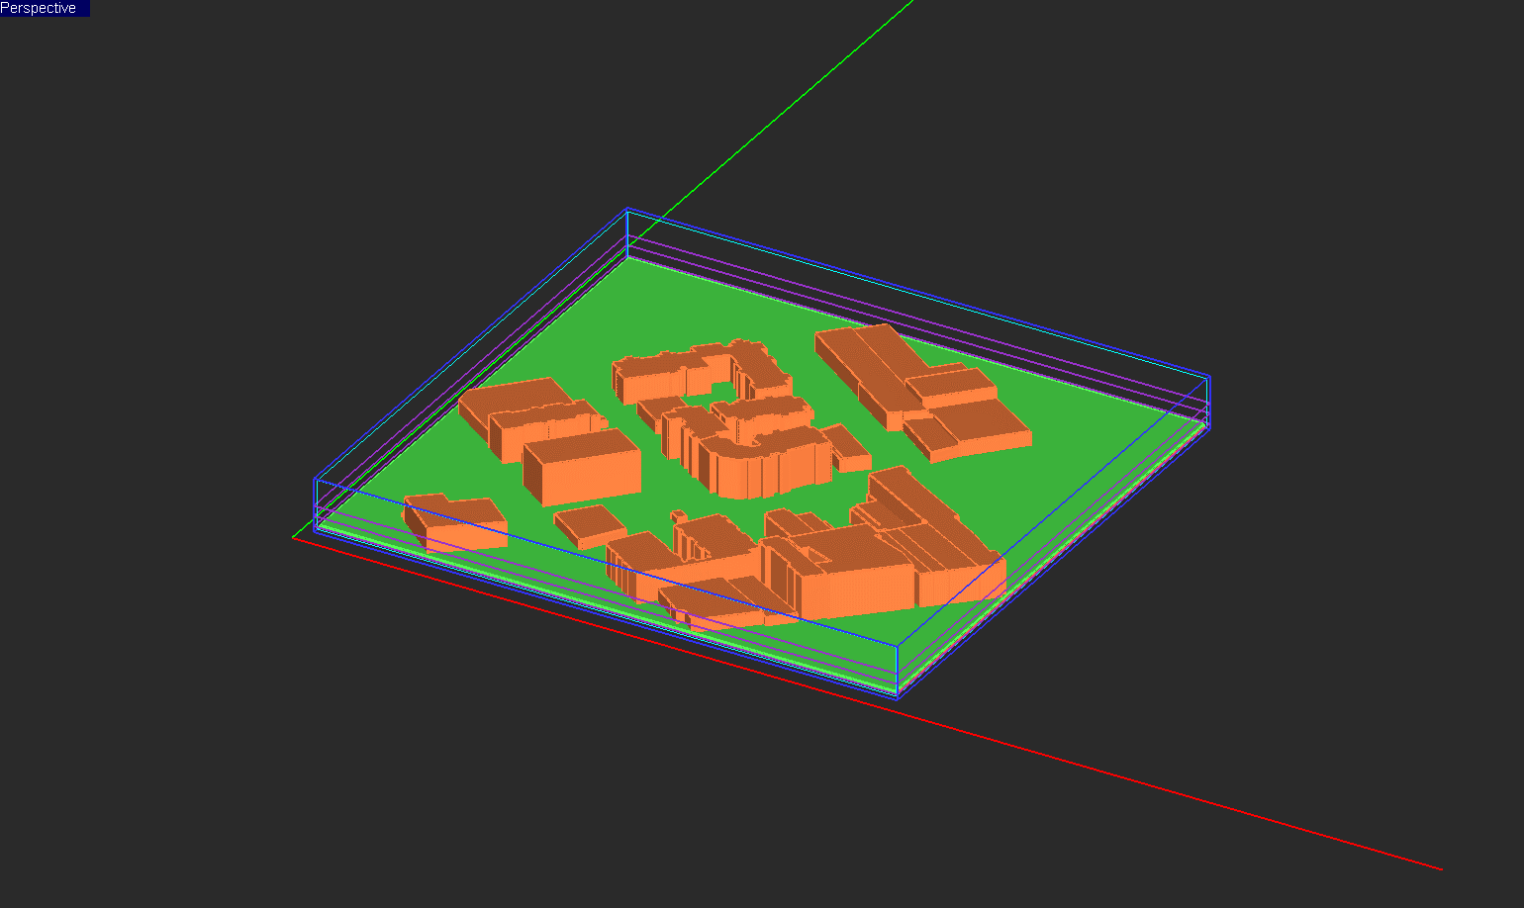
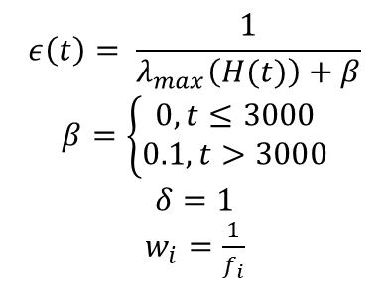
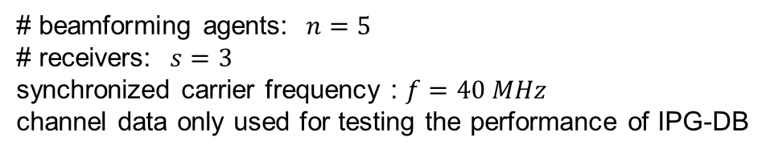
Empirical Results: LA Urban Environment
$$ε\left(t\right)= \frac{1}{λ_{max}\left(H(t)\right)+β}$$
$β=\left\{\begin{aligned}0, t≤3000 \\ 0.1, t>3000\end{aligned}\right.$
$$δ=1$$
$w_{i}=\frac{1}{f_{i}}$
# beamforming agents: $n=5$
# receivers: $s=3$
synchronized carrier frequency : $f=40 MHz$
channel data only used for testing the performance of IPG-DB
A section of Los Angeles
3D CAD model
Physics based simulations using EM.CUBE (ARL Data)

Slide 14
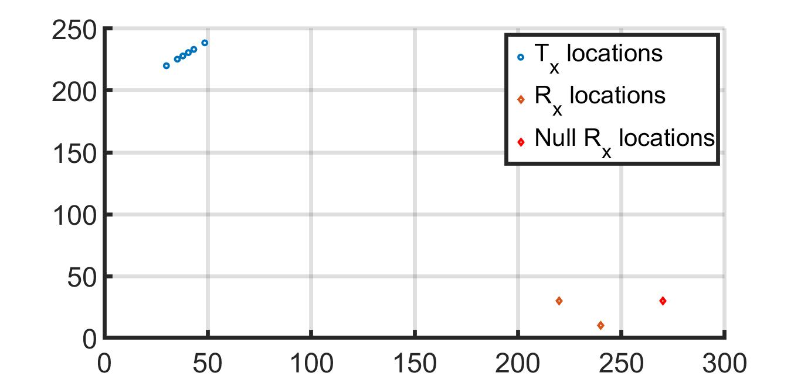
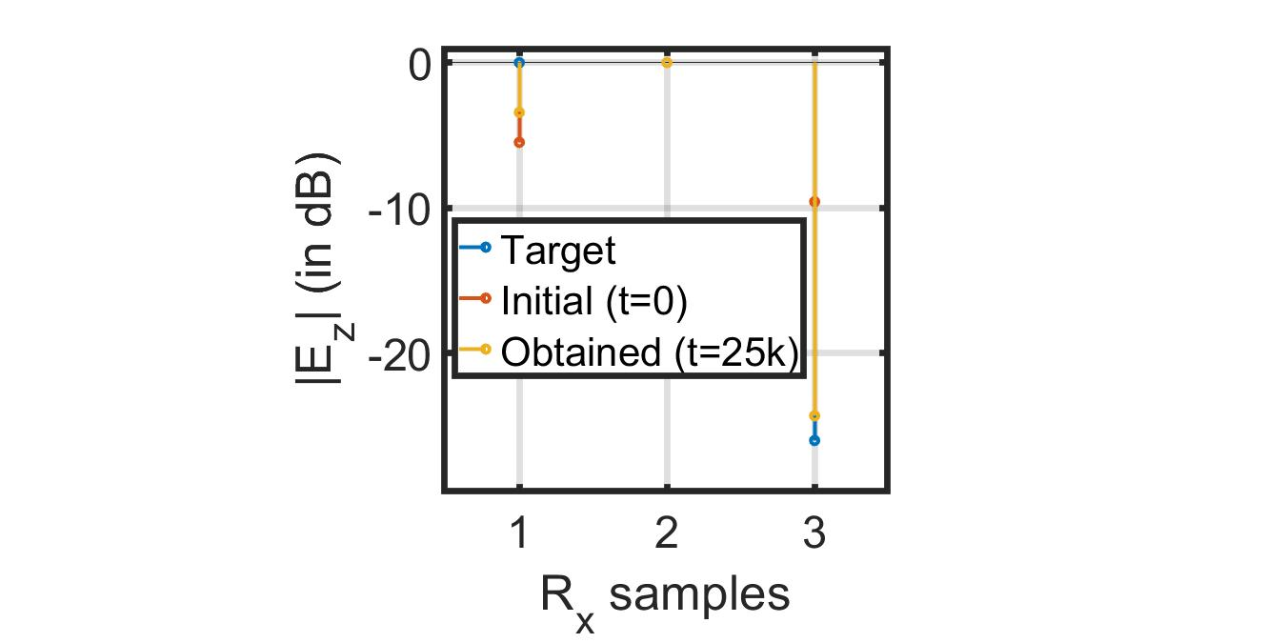
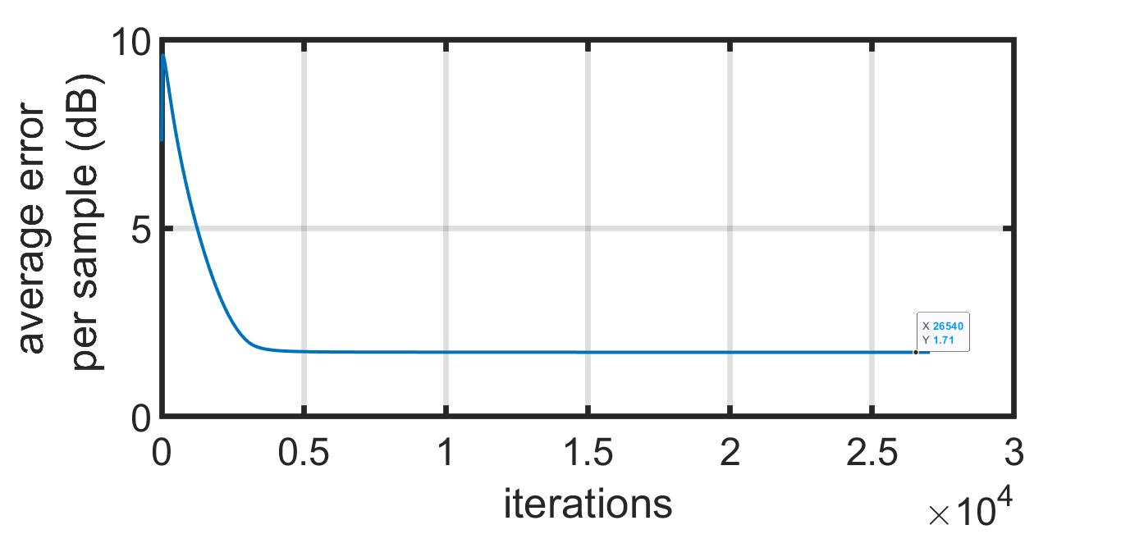
Empirical Results: LA Urban Environment
IPG-DB

Slide 15
Results Obtained and Expected Future Outcomes
Task | Results/Outcomes in Collaboration with ARL
Task 1.6.1 Fundamental limits on desired pattern generation | Characterize constructively the tradeoff between generating an arbitrary far-field radiation pattern and number of deployed robotic systems
Task 1.6.2 Efficient Reinforcement learning for array control | Develop efficient novel policy gradient based RL algorithms to solve the problem of distributed beamforming
Work submitted to: Kushal Chakrabarti, Amrit S. Bedi, Fikadu T. Dagefu, Jeffrey N. Twigg, and Nikhil Chopra. Fast distributed beamforming without Receiver Feedback. In 2016 56th Annual Asilomar Conference on Signals, Systems, and Computers. 2022. (under review)

Slide 16
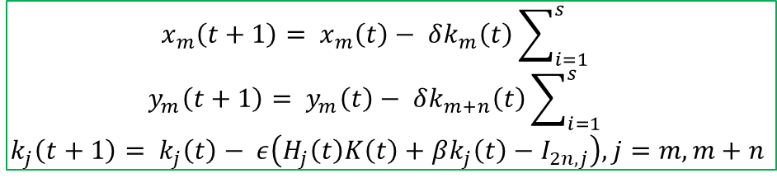
Alternate Framework: Position Optimization IPG-DB
agent $m$: $\left(a_{m}(t),α_{m}(t)\right)$, server: $K\left(t\right) ∈ ℝ^{2n×2n}$
server broadcasts to each agent: $ε, β, δ, K(0)$
For each iteration $t≥0$:
$$ζ_{im}=kx_{m}\cos{θ_{i}}+ky_{m}\sin{θ_{i}+kd_{im}}$$
$u_{im}(t)=\frac{1}{d_{im}}\cos\left(α_{m}\left(t\right)+ζ_{im}\right)$, $v_{im}\left(t\right)=\frac{1}{d_{im}}\sin\left(α_{m}\left(t\right)+ζ_{im}\right)$, $y_{im}\left(t\right)=a_{m}(t)\left(u_{im}\left(t\right)+jv_{im}(t)\right)$
at each agent $m$
agent $m$ to server
$k_{j}\left(t\right):j$-th row of $K\left(t\right)$
$H_{j}(t)$: Hessian, locally computed
at server
server to each agent $m$
at each agent $m$
$$x_{m}\left(t+1\right)= x_{m}\left(t\right)− δk_{m}\left(t\right)\sum_{i=1}^{s}{}$$
$$y_{m}\left(t+1\right)= y_{m}\left(t\right)− δk_{m+n}\left(t\right)\sum_{i=1}^{s}{}$$
$$k_{j}\left(t+1\right)= k_{j}\left(t\right)− ε\left(H_{j}\left(t\right)K\left(t\right)+βk_{j}\left(t\right)−I_{2n,j}\right), j=m,m+n$$

Slide 17
Reinforcement Learning: Sparse Bayesian Learning
SBL Implementation based on: Anjaly Parayil, Amrit Singh Bedi, and Alec Koppel, Joint Position and Beamforming Control via Alternating Nonlinear Least-Squares with a Hierarchical Gamma Prior, 2021 American Control Conference (ACC)
Notes:
\[\min_n\[\min_{\{r_i,w_i\}^n_{i=1}}||\textbf{AF} - \textbf{AF}_d||^2_2, \ \ \
\textbf{AF} = \textbf{H(r)w}, \ \ \ [\textbf{H(r)}]_{m,i} = e^{jk(x_mcos\theta_i + y_msin\theta_i)}

Slide 18
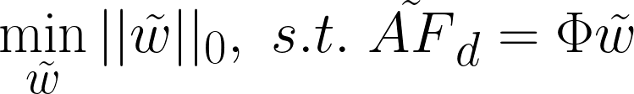
Multilevel Optimization: Approach
Level 1: Sparse Bayesian Learning
Initial Tx weight guess satisfying:
Level 2: IPG-DB
2.1 – Phase/Amplitude Optimization
2.2 – Position Optimization

Slide 19
Multilevel Optimization: Results

